Slide 1
SOFTWARE PROJECT LAB-1
Name: Asshifa Sultana
Roll no. : BSSE-1632

Slide 2
Project title- Stegofusion- a hybrid algorithm based image steganography system
Supervised by,
Dr. Emon Kumar Dey
Associate Professor
IIT, University of Dhaka

Slide 3
Image steganography
Image Steganography refers to the process of hiding data within an image file. The image selected for this purpose is called the cover image and the image obtained after steganography is called the stego image.

Slide 4
Project Overview-
Securely hides text data inside BMP images using multiple algorithms.
Integrates compression, error detection and lsb embedding.
Uses randomized pixel selection to avoid detectable patterns.
Preserves image quality with minimum visual distortion.

Slide 5
Algorithms-
Huffman Coding
Hamming Coding
Chaos Mapping
LSB Embedding
Compresses text data using binary tree based on character frequency to reduce size.
Detects and corrects bit errors using parity bits and bitwise operations.
Randomizes data embedding positions through iterative non-linear equations for unpredictability.
Hides data bits in an image’s pixel array by altering the least significant bits of pixel values.

Slide 6
Tasks implemented so far-
Reading and processing 24-bit BMP images.
Huffman compression and decompression.
Min heap based Huffman tree construction.
Bitstream encoding and decoding.
Basic logistic map chaotic sequence.
LSB based data embedding and extraction.

Slide 7
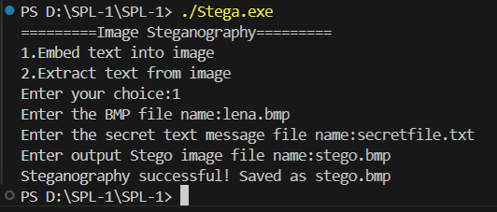
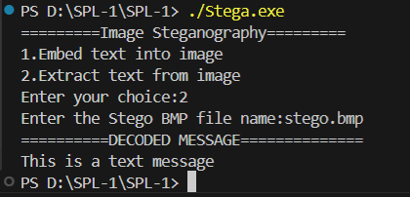
PROGRAM OUTPUT
Text embedding
Text extracting

Slide 8
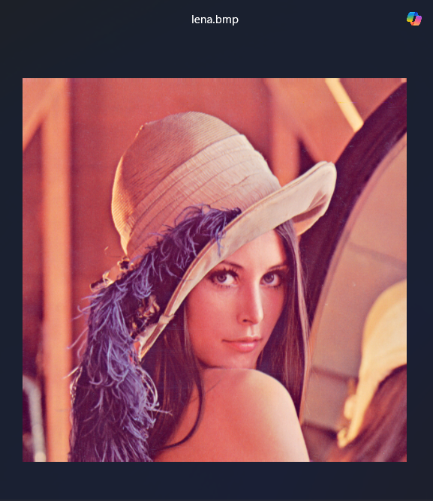
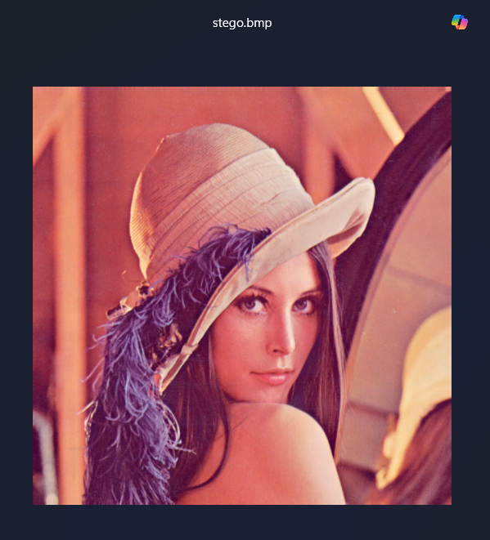
PROGRAM OUTPUT
Before embedding
After embedding

Slide 9
Tasks to be implemented
Add Hamming Code for error detection and correction
Support both 24 and 32 bit BMP images
Multiple chaotic maps for more secure and unpredictable embedding

Slide 10
THANK YOU
Email: bsse1632@iit.du.ac.bd
GitHub Link: https://github.com/asshifasultana/SPL-1.git

